Slide 1
Mobile Game Performance Overview As of 1st June, 2024 To 1st August, 2024
Find a detailed report here (Power BI visuals)

Slide 2
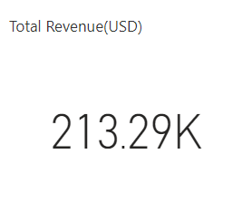
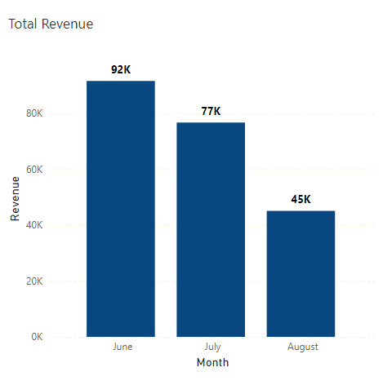
Recorded Revenue
Total Revenue: 213.29K June: Highest revenue (91,546.00) July: Decline to 76,670.00 August: Lowest at 45,076.00

Slide 3
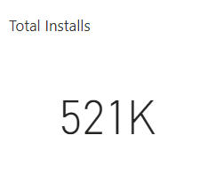
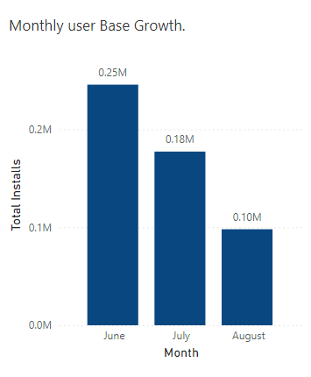
User Base Growth
Total Installs: 521K There’s a clear downward trend in new user installs from June to August: June to July: 28% decline. July to August: 44% decline.

Slide 4
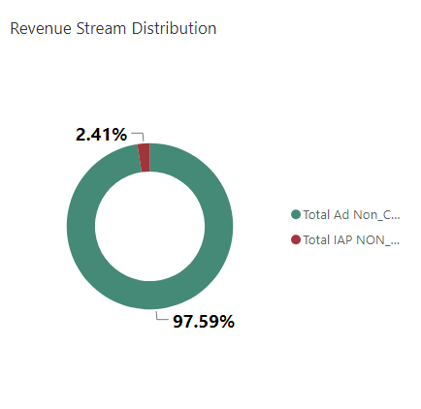
Revenue Generation Streams.
Ad Revenue Dominance: Ad revenue constitutes the vast majority of the revenue stream at 97.59%. This indicates a heavy reliance on ad-based income.
In-App Purchases (IAP): Only 2.41% of total revenue is generated through in-app purchases, suggesting a limited contribution from this channel.

Slide 5
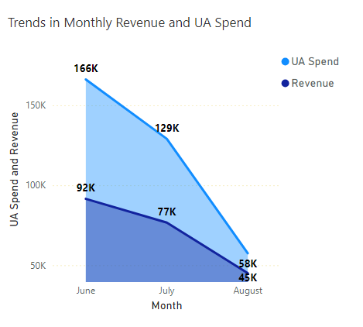
Trends In Revenue Generation vs UA Expenditure
Decline in UA Spend and Revenue Over Time: Both User Acquisition (UA) Spend and Revenue have seen a consistent decline from June to August.
While UA Spend is consistently higher than the Revenue in each month, the gap between them is decreasing over time.

Slide 6
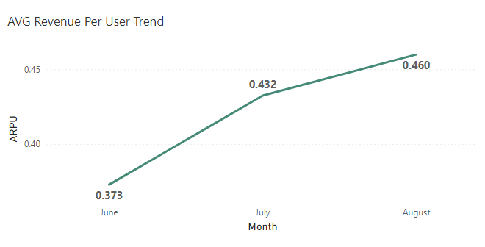
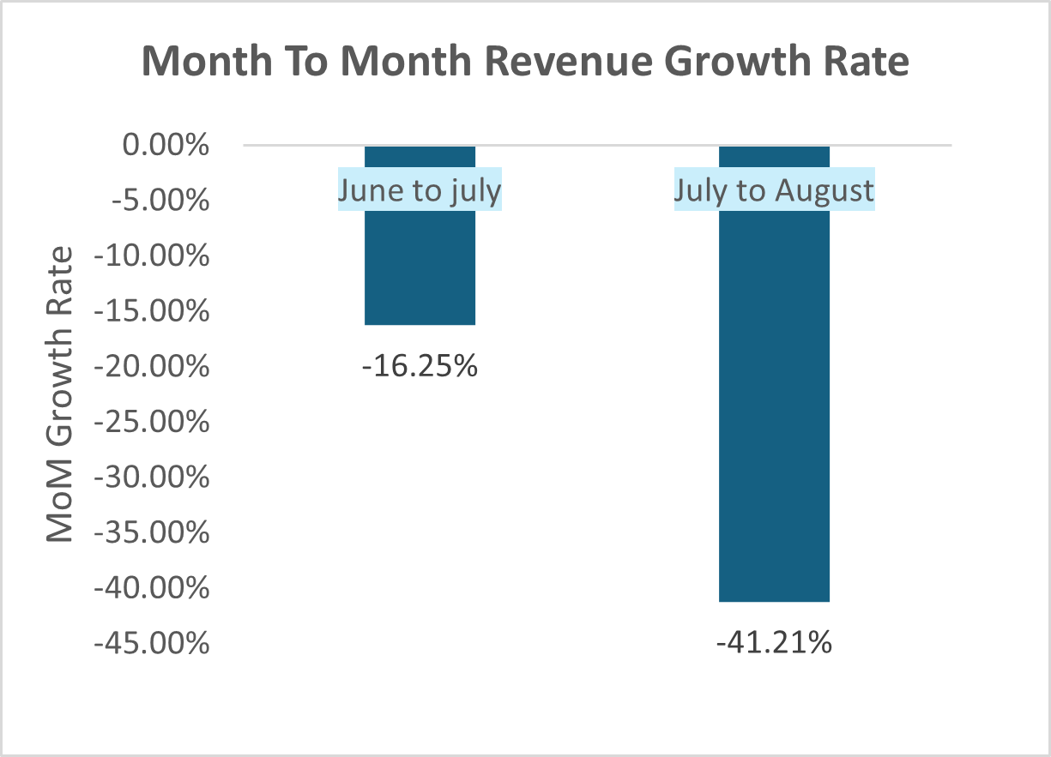
Average Revenue Per User
Increasing ARPU: Average revenue per user (ARPU) rose consistently from 0.373 in June to 0.460 in August, showing improved monetization per user.
Declining Revenue Growth Rate: Despite higher ARPU, the month-over-month revenue growth rate dropped significantly, with a 16.25% decrease from June to July and 41.21% decrease from July to August.
The growth rate decline suggests a possible reduction in active user numbers or slower user acquisition, limiting total revenue growth despite higher revenue per user.

Slide 7
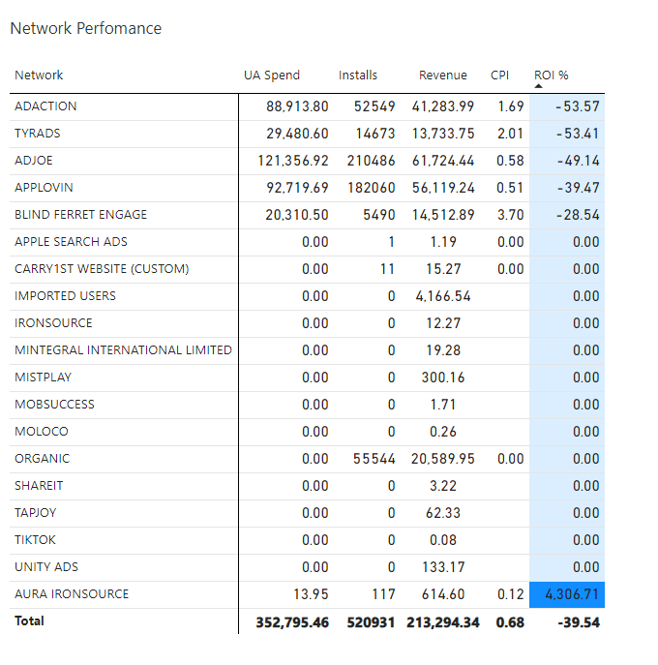
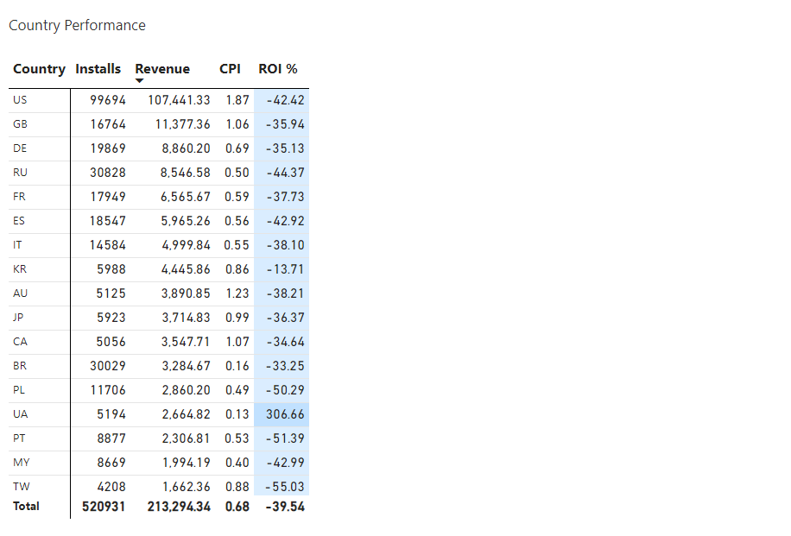
Country & Network Performance.

Slide 8
Recommendation
Focus on Conversion Optimization: For networks with high installs but low revenue (e.g., Organic and TikTok), review user experience and conversion funnels post-installation. Identifying bottlenecks in the customer journey could increase monetization potential without needing additional spend.
Improve Ad Creatives and Messaging: Experiment with creative variations and messaging on underperforming networks to increase engagement and conversion rates. This might help increase the return without further increasing the ad spend.
Regularly Monitor and Adjust: Track each network's performance weekly or monthly. Identify trends early to make budget adjustments promptly, ensuring the best-performing networks receive an adequate budget while minimizing losses from low-performing ones.
Find a detailed report here (Power BI visuals)

